Slide 1
Where Are You From?
Kinnect 2021 Lesson

Slide 2
Introductory Activity
Class Rules:
Do your best! We know you can all work really hard!
Be respectful to everyone. We are all different! We don’t dance the same, and that’s okay! And BE SAFE!
3, 2, 1 Freeze!
Review rules and get started!
Have you ever moved to a new house before?
Have you ever changed classes?
How did it FEEL to change? Exciting? Scary?
Did you move really FAR away?
Did you move really close?
Introduce the book:
Where are YOU From?
Notes:
If changing g a class or house or even state was scary for you you are going to shake and vibrate as much as you can when I say go. Not yet. If it was exciting for you, you are going to make a huge shape. If you were scared and excited do both. Shake while making a big shape when I say go 1,2, 3 go! Notice how everyone can feel different ways!

Slide 4
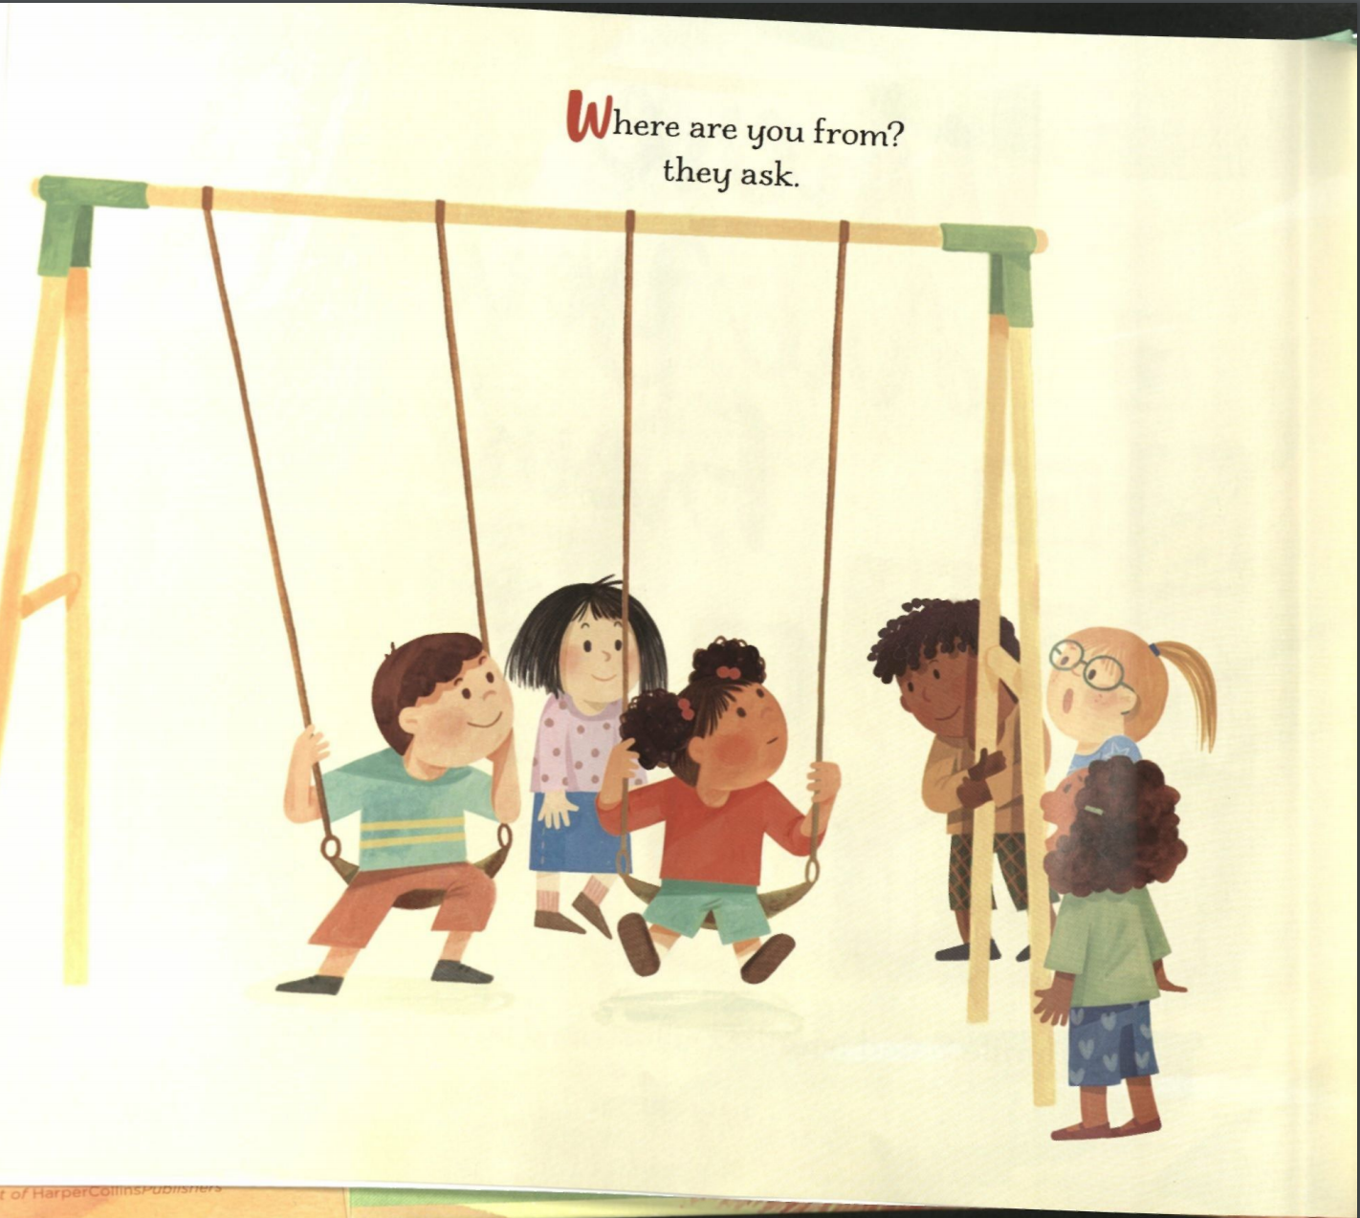
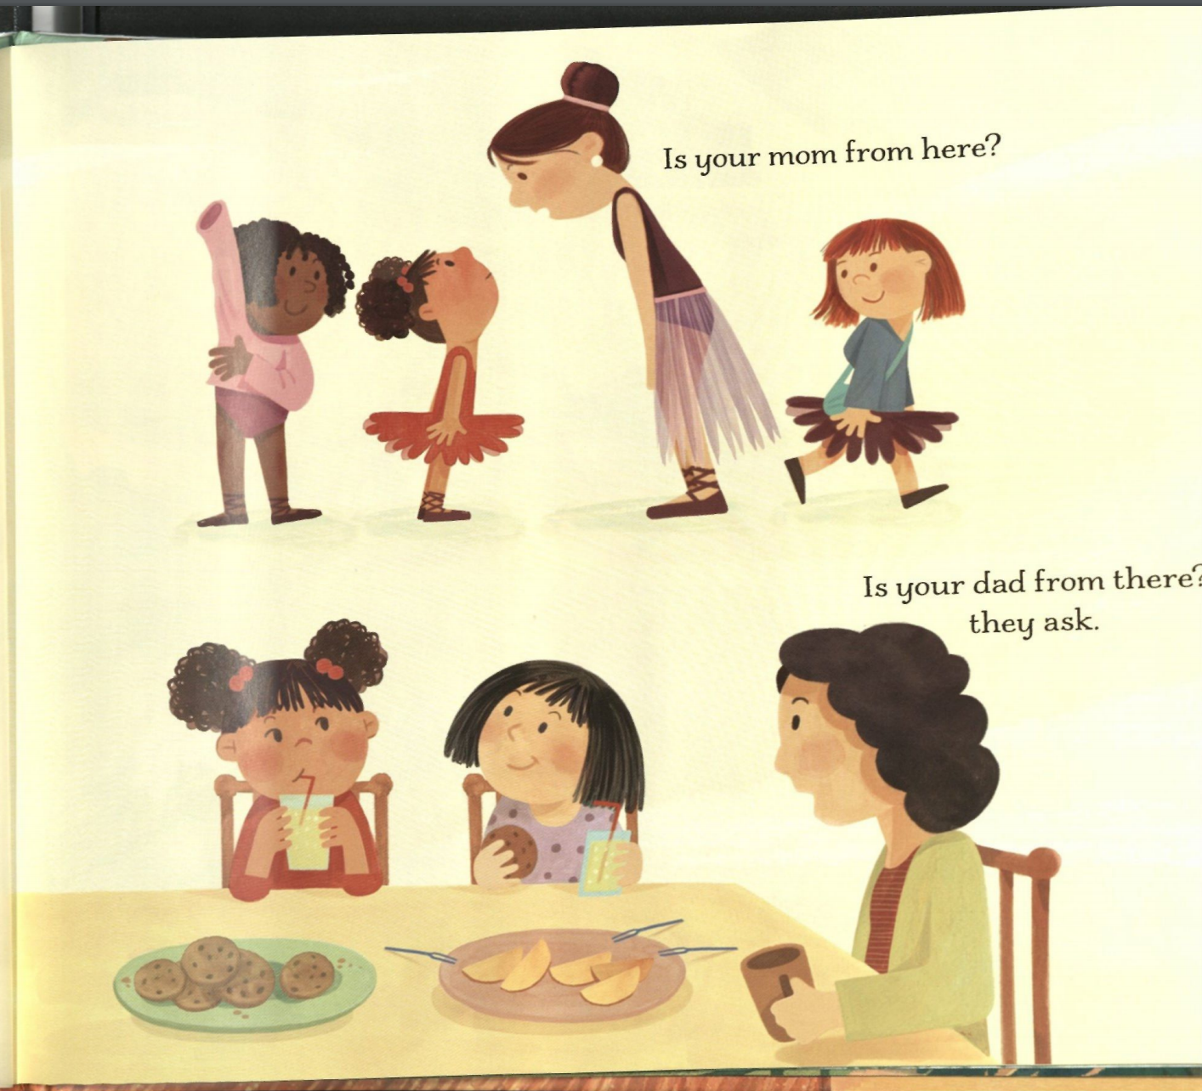

Slide 5
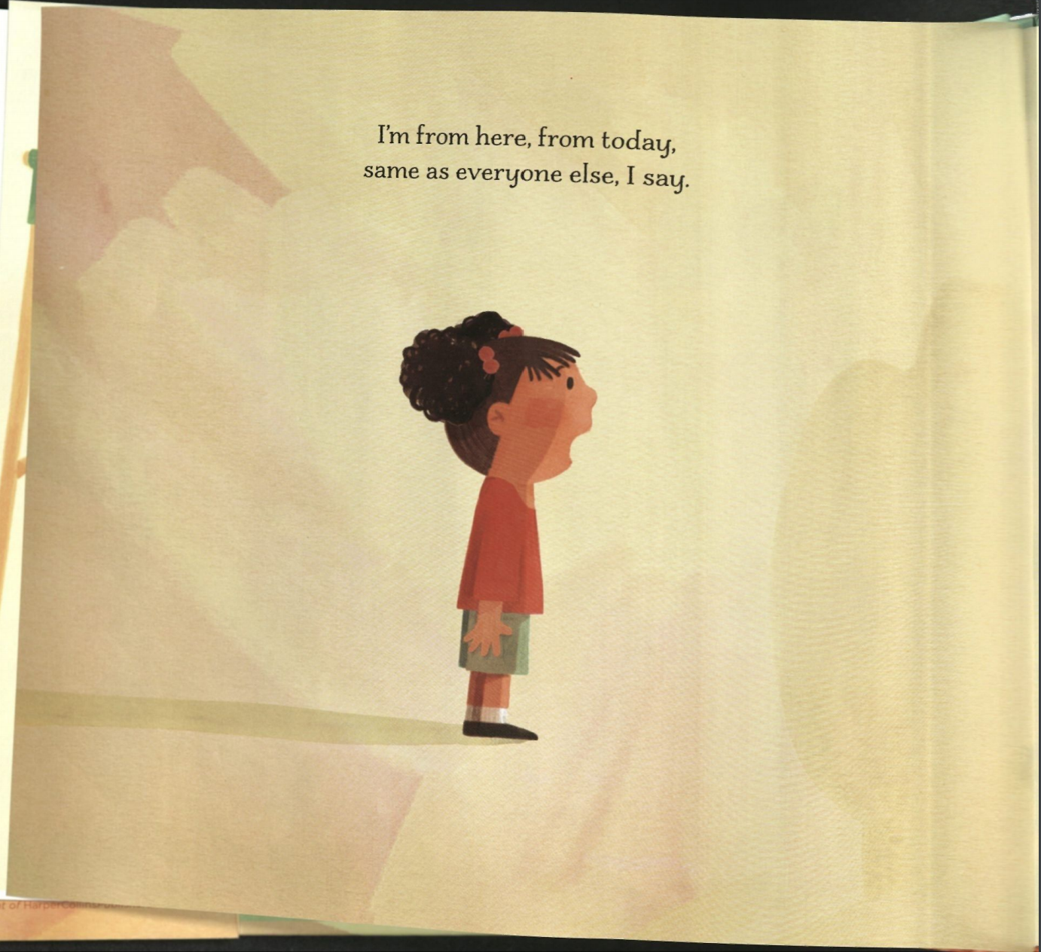
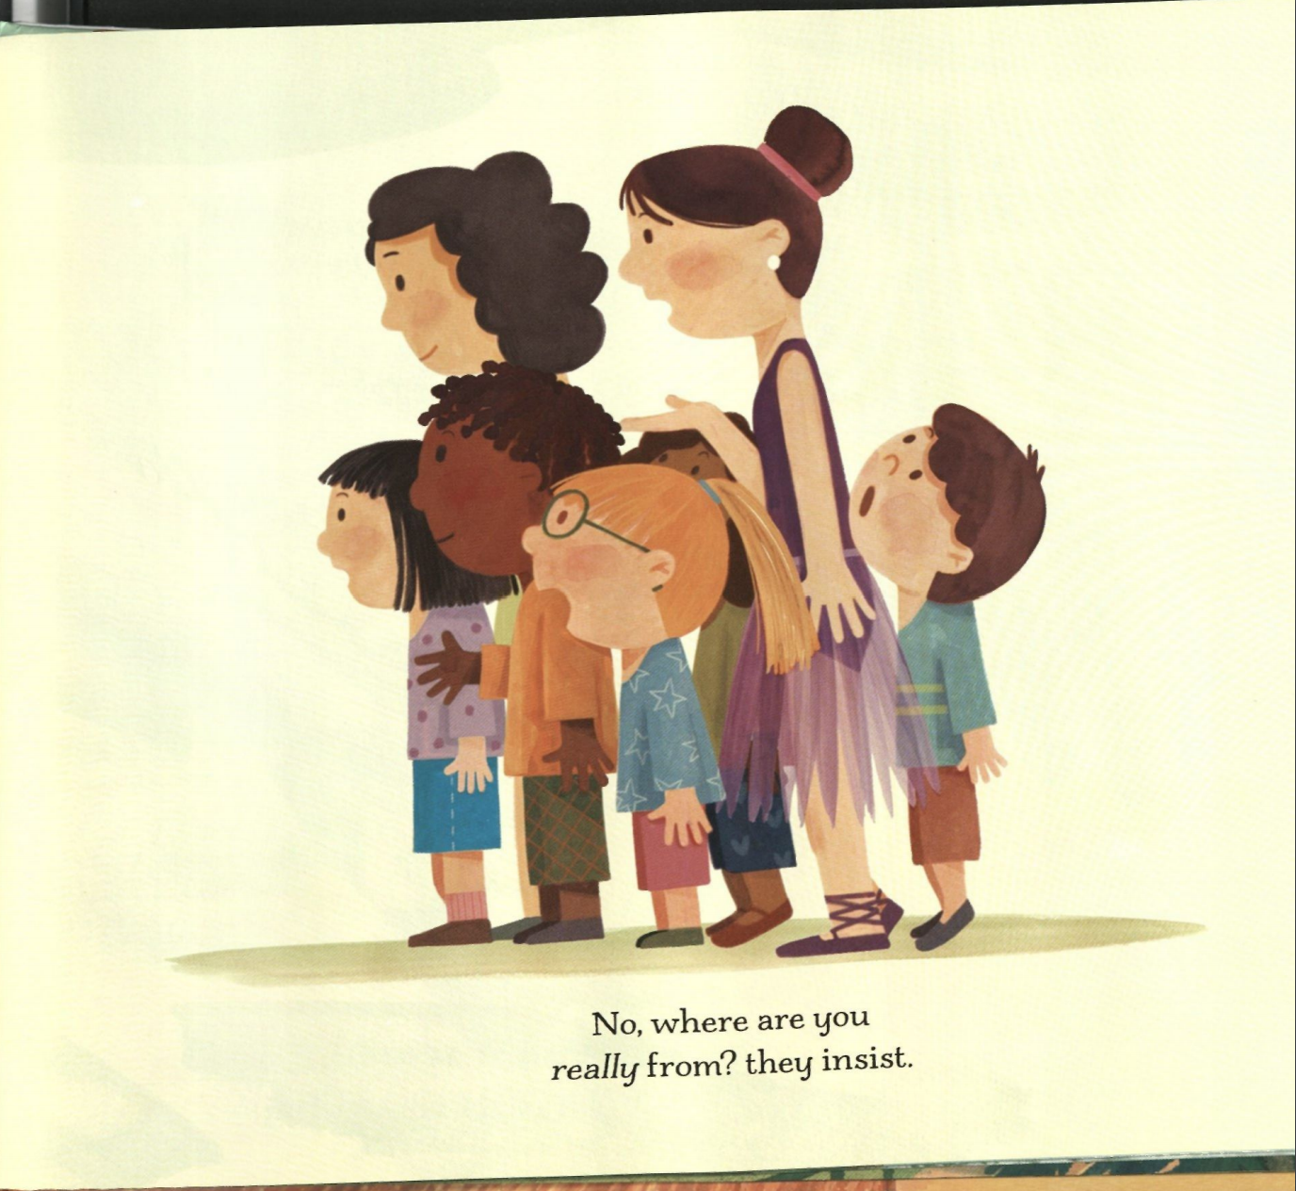

Slide 6
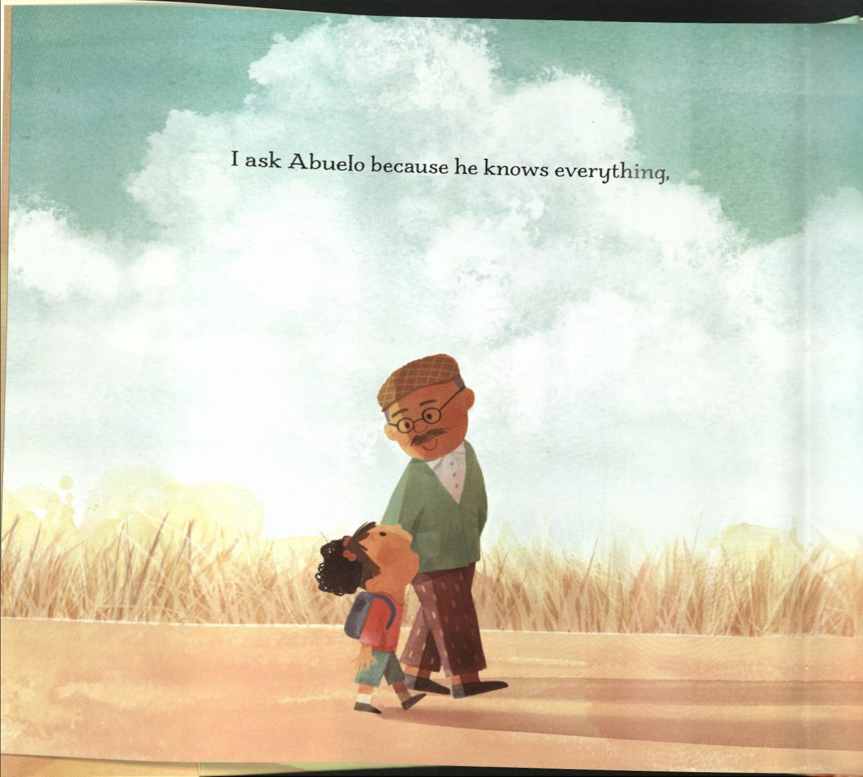
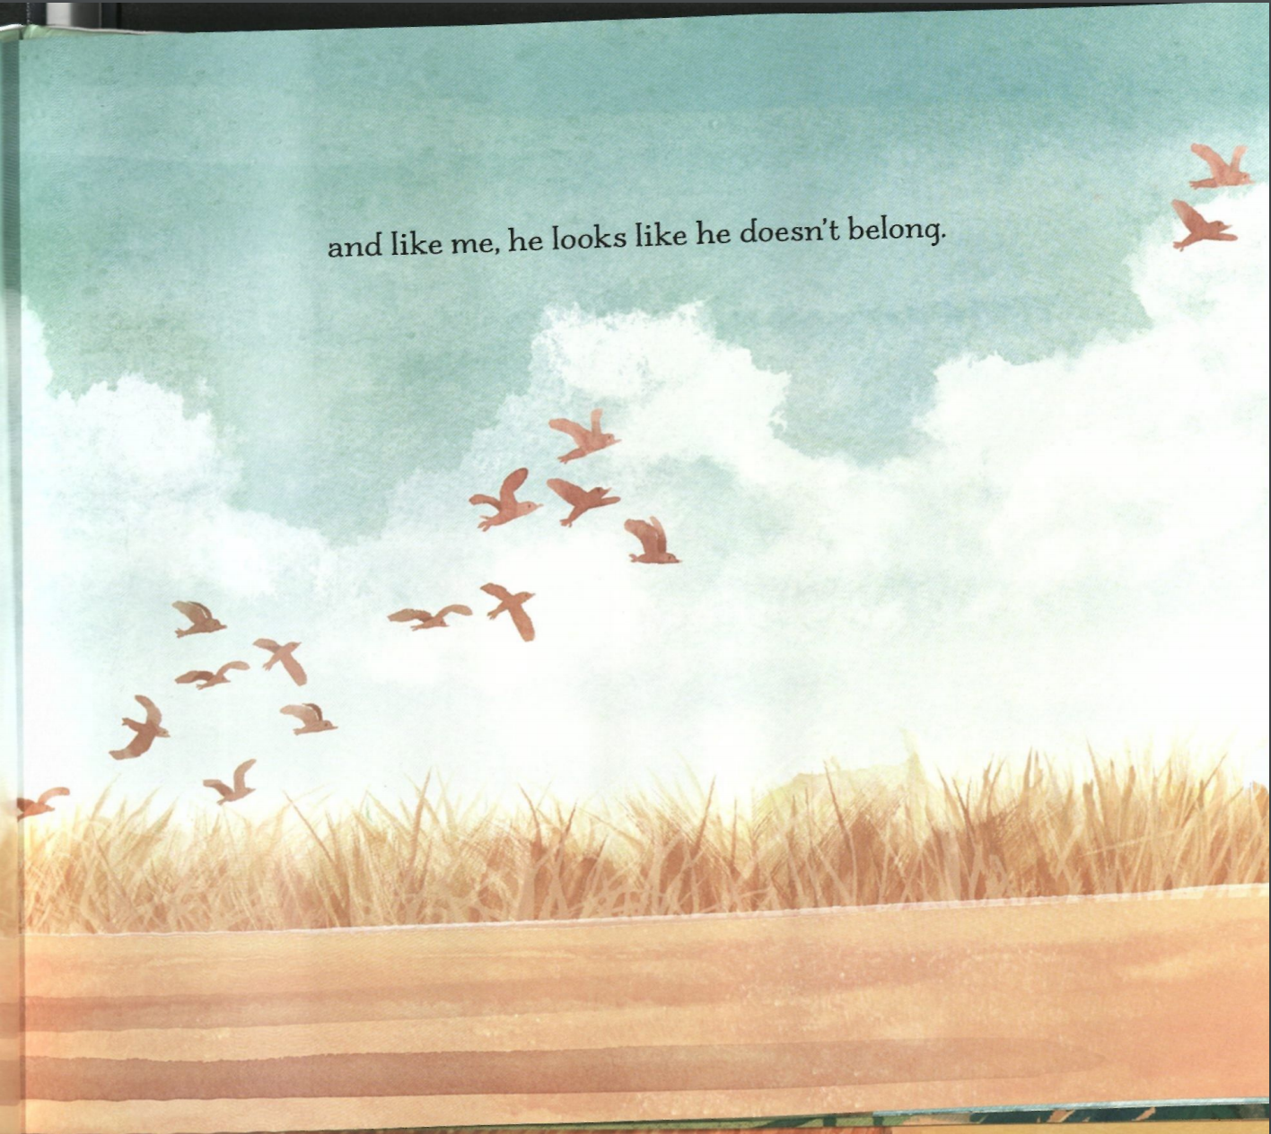

Slide 7
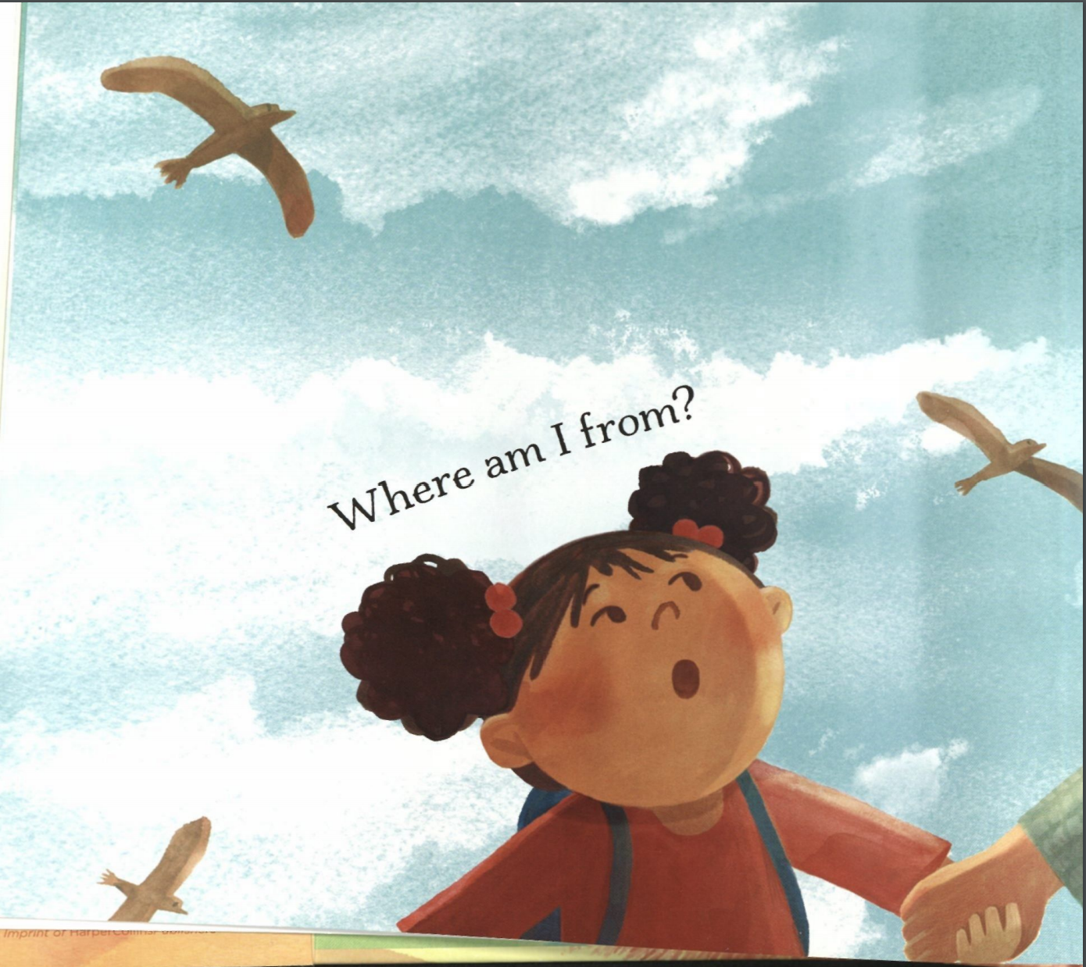
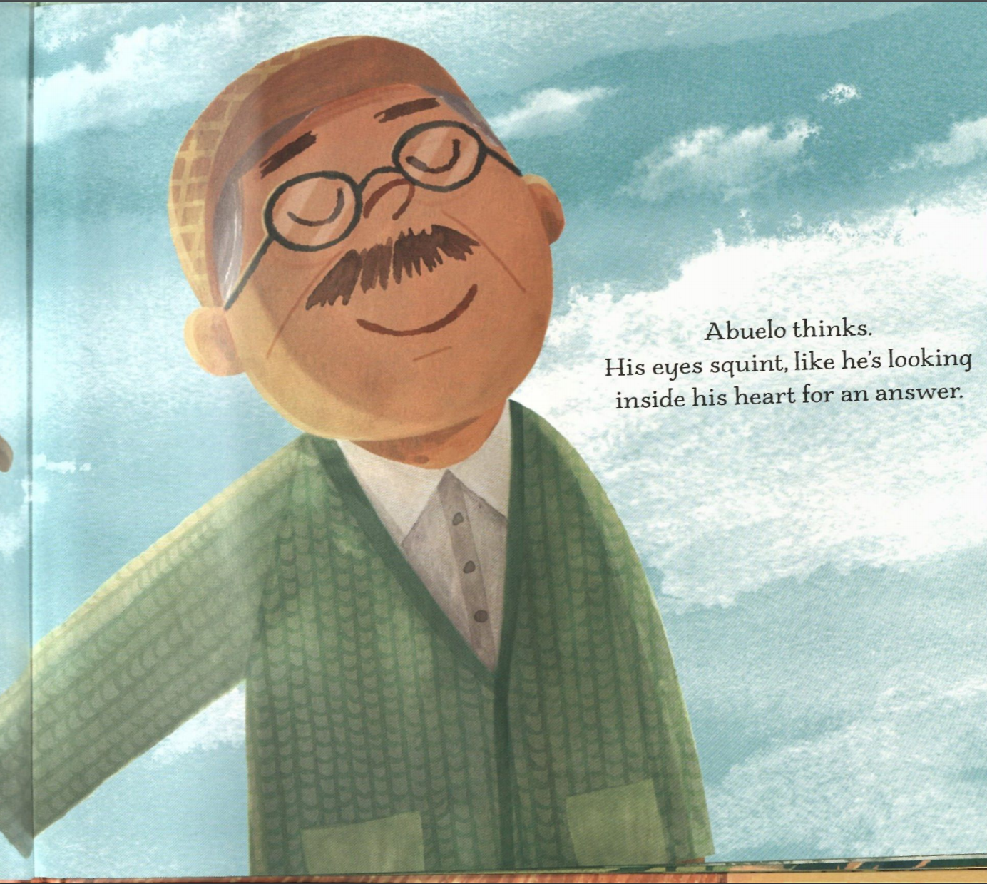

Slide 8
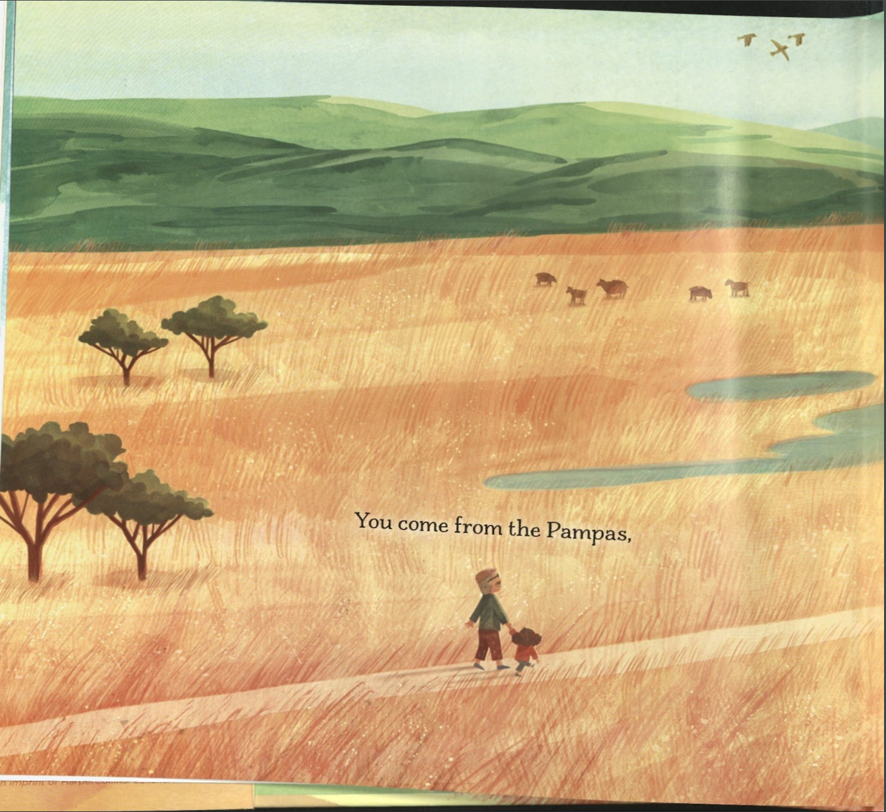
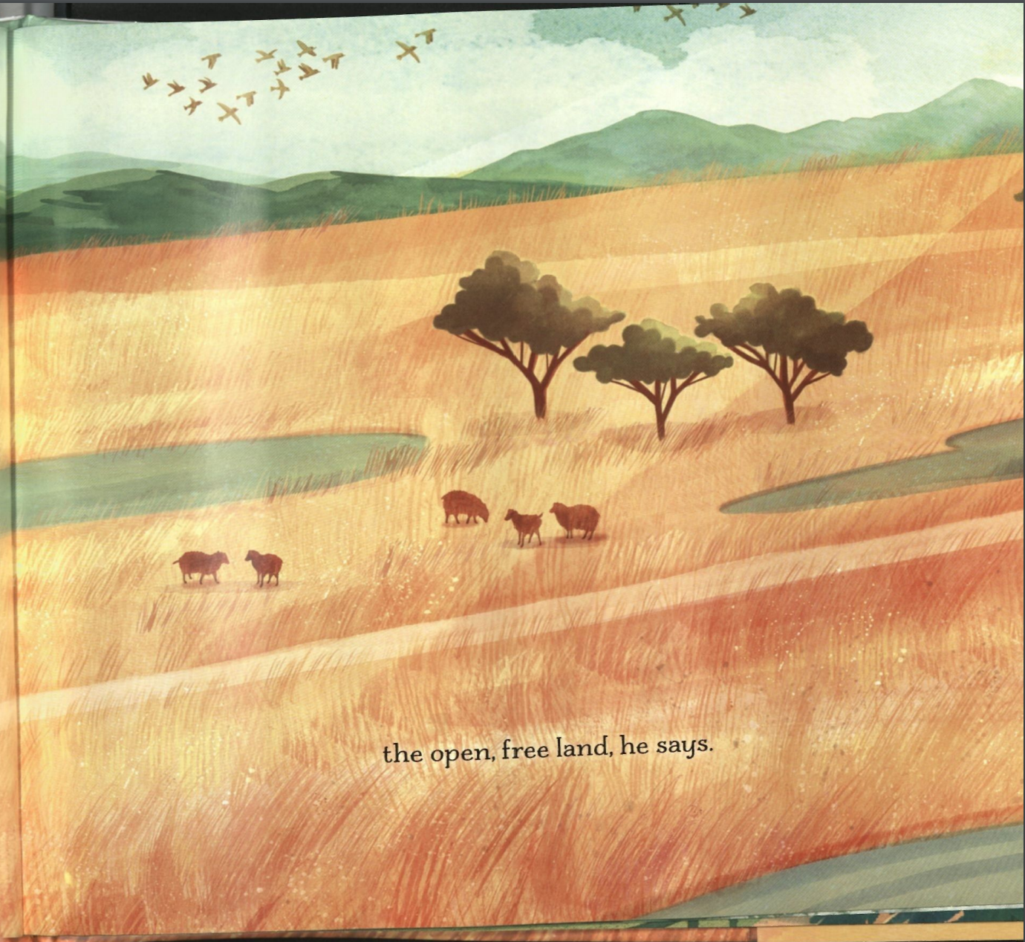
Can we… SKIP, TWIRL, SWAY, or JUMP?
Can we show each other how big the space is with our EYES?
Notes:
Pampas is word for a large open field---- Do you notice the grass swaying the in the breeze and animals grazing? We are going to show how big the space is by how big we can move by skipping twirling swaying and jumping. Dance. How high can you sway? How low can you jump? How much can you travel as you twirl?

Slide 9
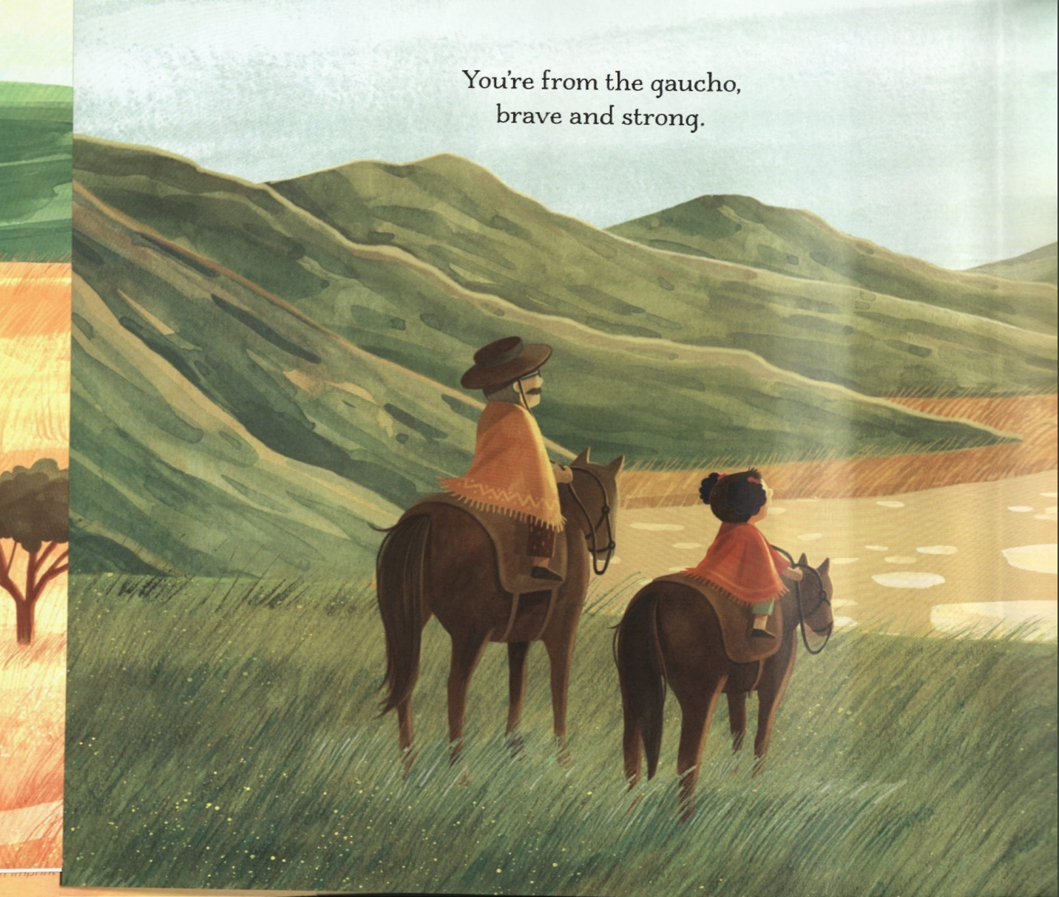
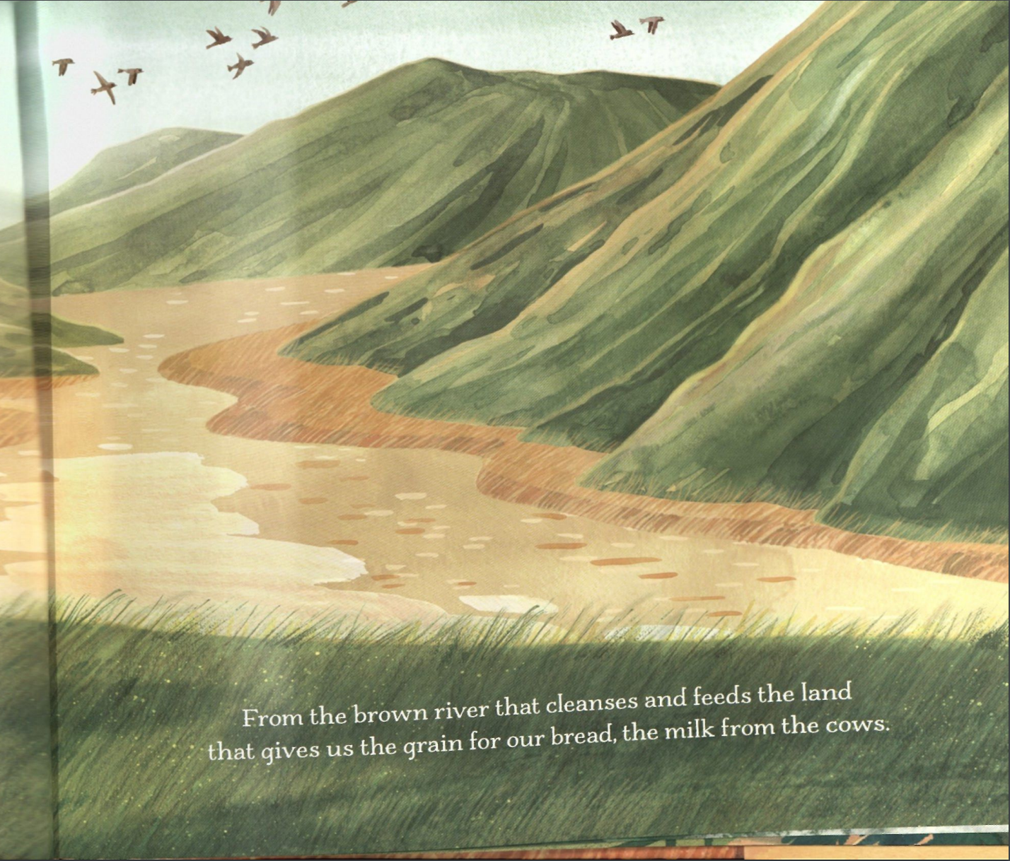
How would a SMOOTH river move? How would a FAST river move?
Is our river moving in a straight line? Are we moving around a lot of rocks?
Notes:
Sometimes we just want to stay in one place and take our time sometimes we want to move around and explore as many new places as possible Gaucho: Water, direct (the river knows exactly where to go, powerful rivers know how to move around the rocks in their way), zig zag, balance, low SMOOTH RIVER (slower and lighter movements)/FAST RIVER (strong, sustained)
I want you to think in your head? Did it feel more comfortable to move slow or fast most of the time?

Slide 10
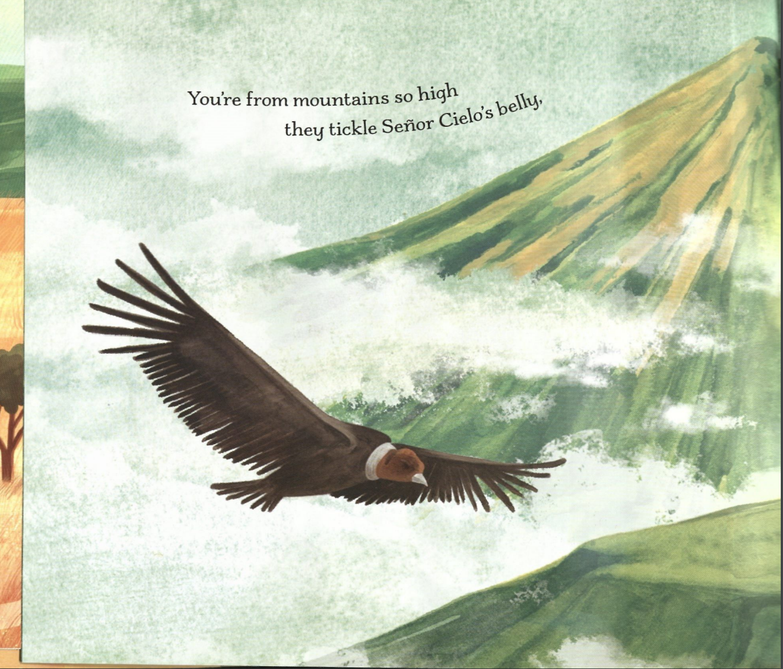
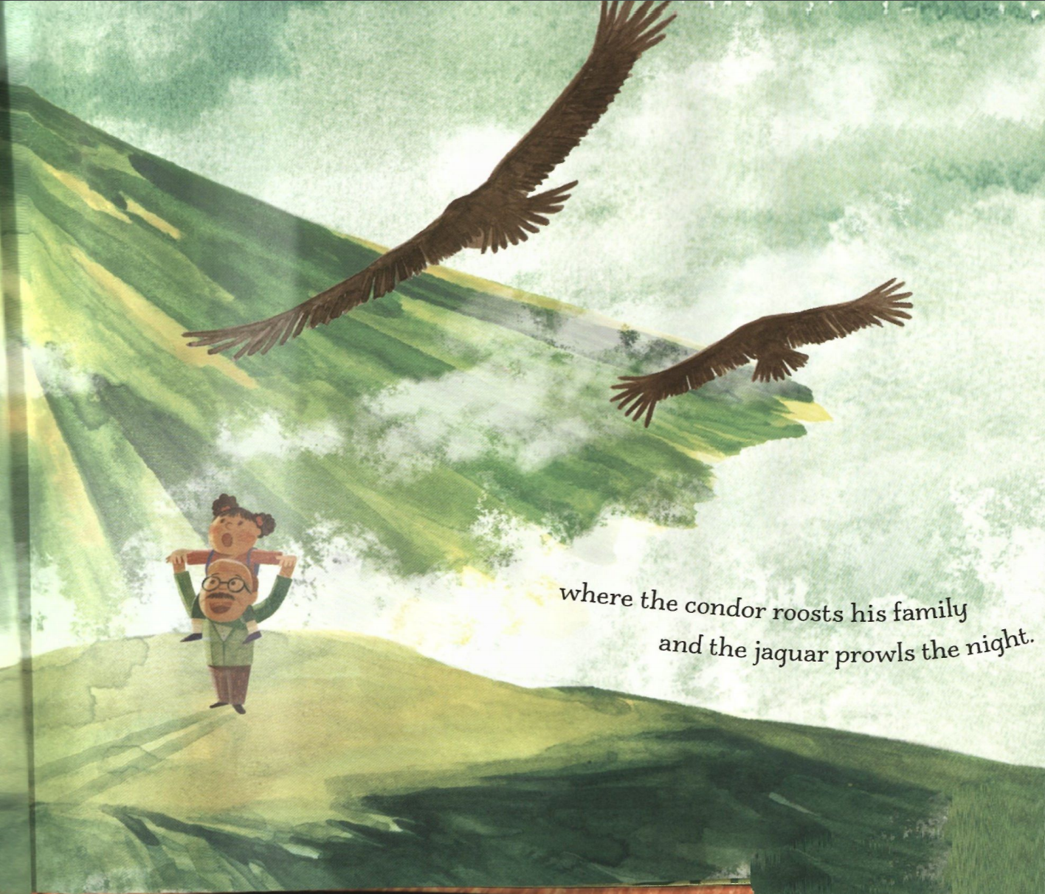
Notice how high these mountains are? What else is tall?
Notes:
Do you see how-This girl comes from a place with mountains. Some places don’t have mountains they have tall skyscrapers or volcanoes. We are going to move light and airy like the things we see in this picture. Can you imagine jumping twirlinga and dancing around like a leaf driting in the air, snow falling from the sky, a bubble drifting? When I say go we are going to move around lightly. Then when you hear me yell pause. You are going to freeze and slowly sink to the floor as sloooooowww as light as possible.
What do you wantt them to know-- feel be able to move? Iw ant them to understand we all come from different places and have something to contribute. Its about hte students
As they are going out the door----- tell me oneway you tonoticed that your partner moves ismiliariy or differently than you.
What would that look like?

Slide 11
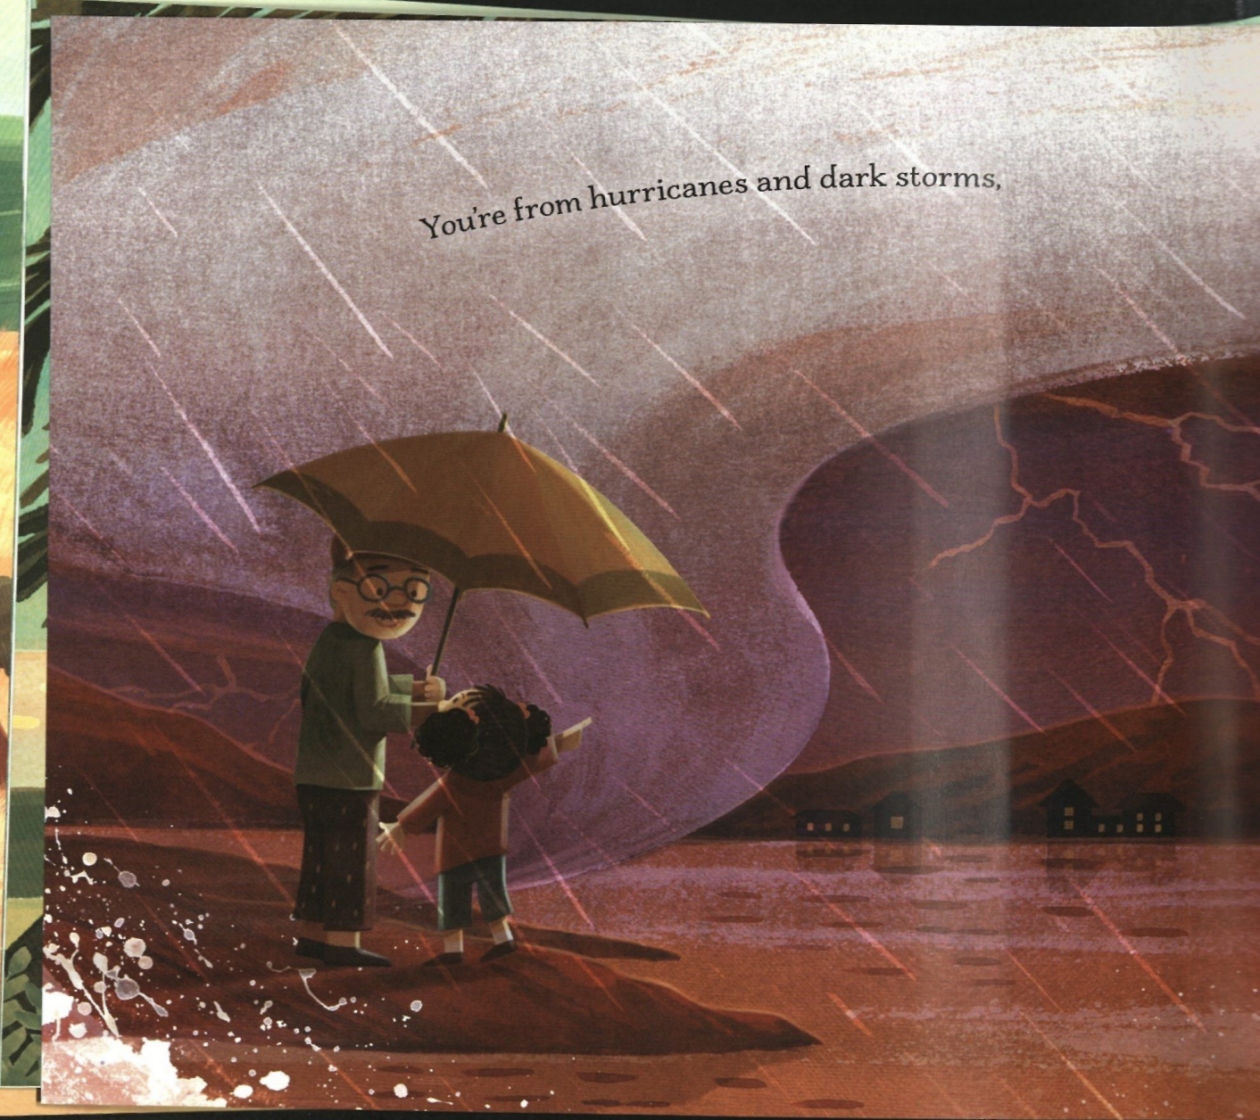
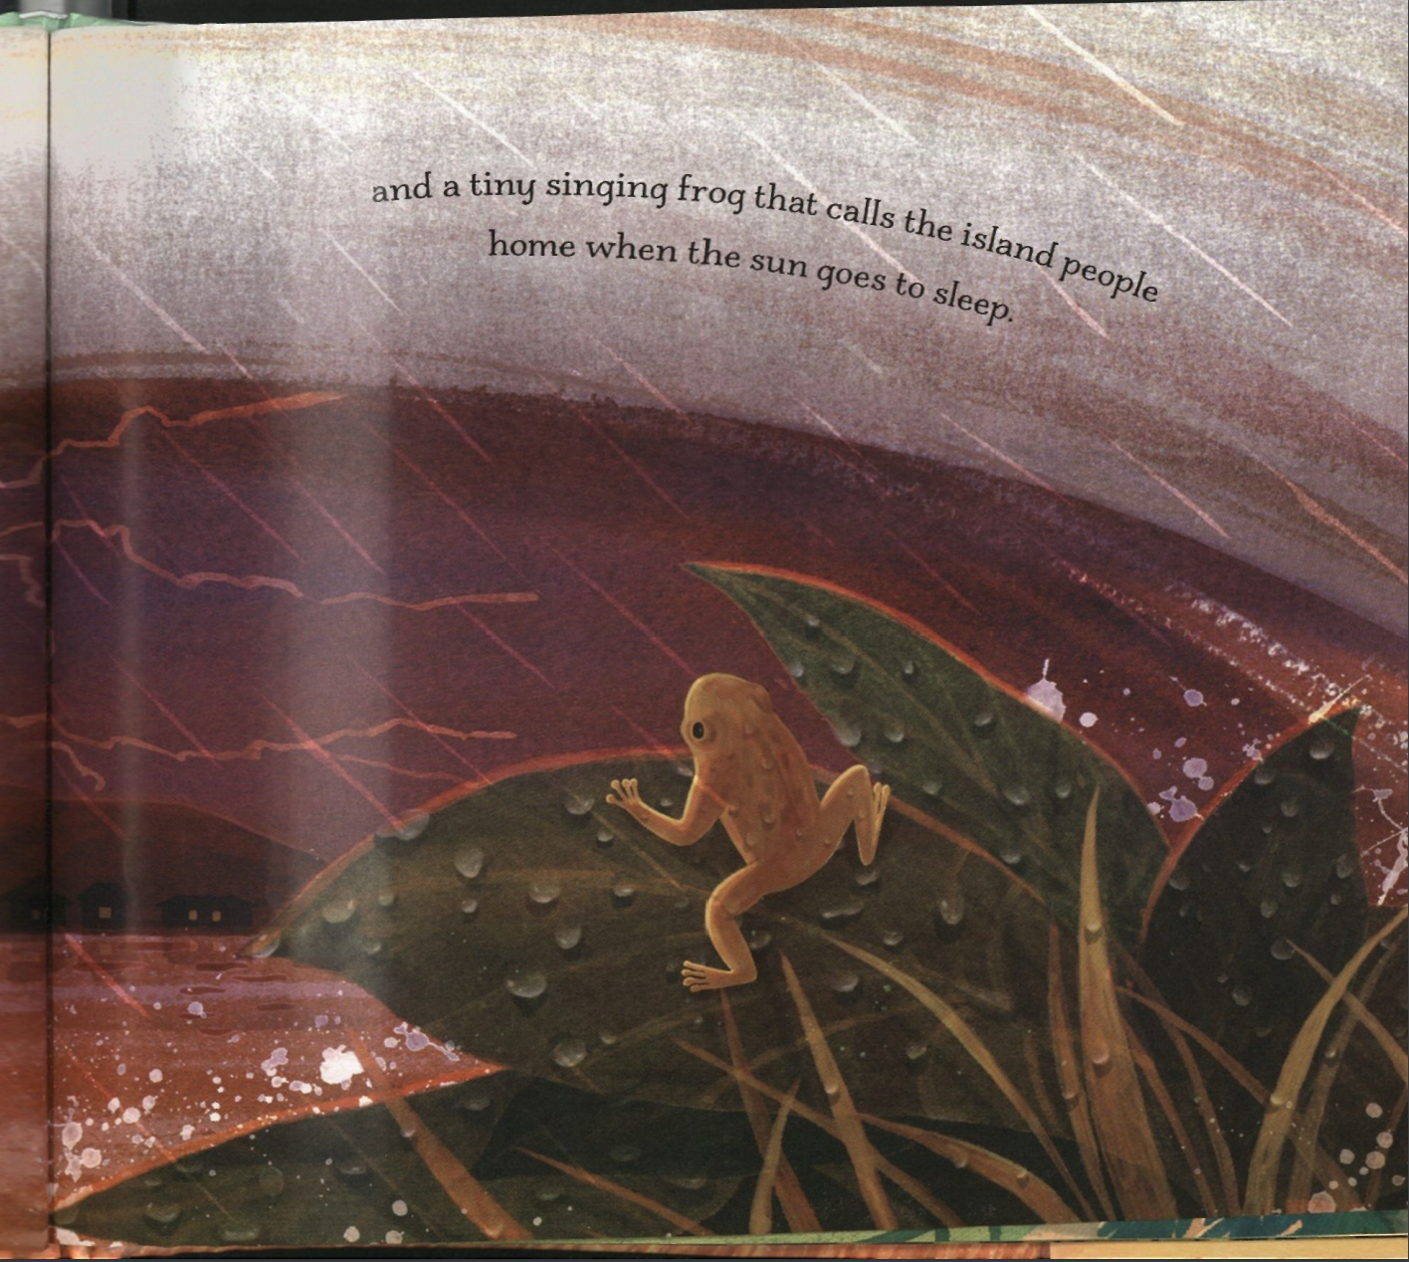
Notes:
Just read

Slide 12
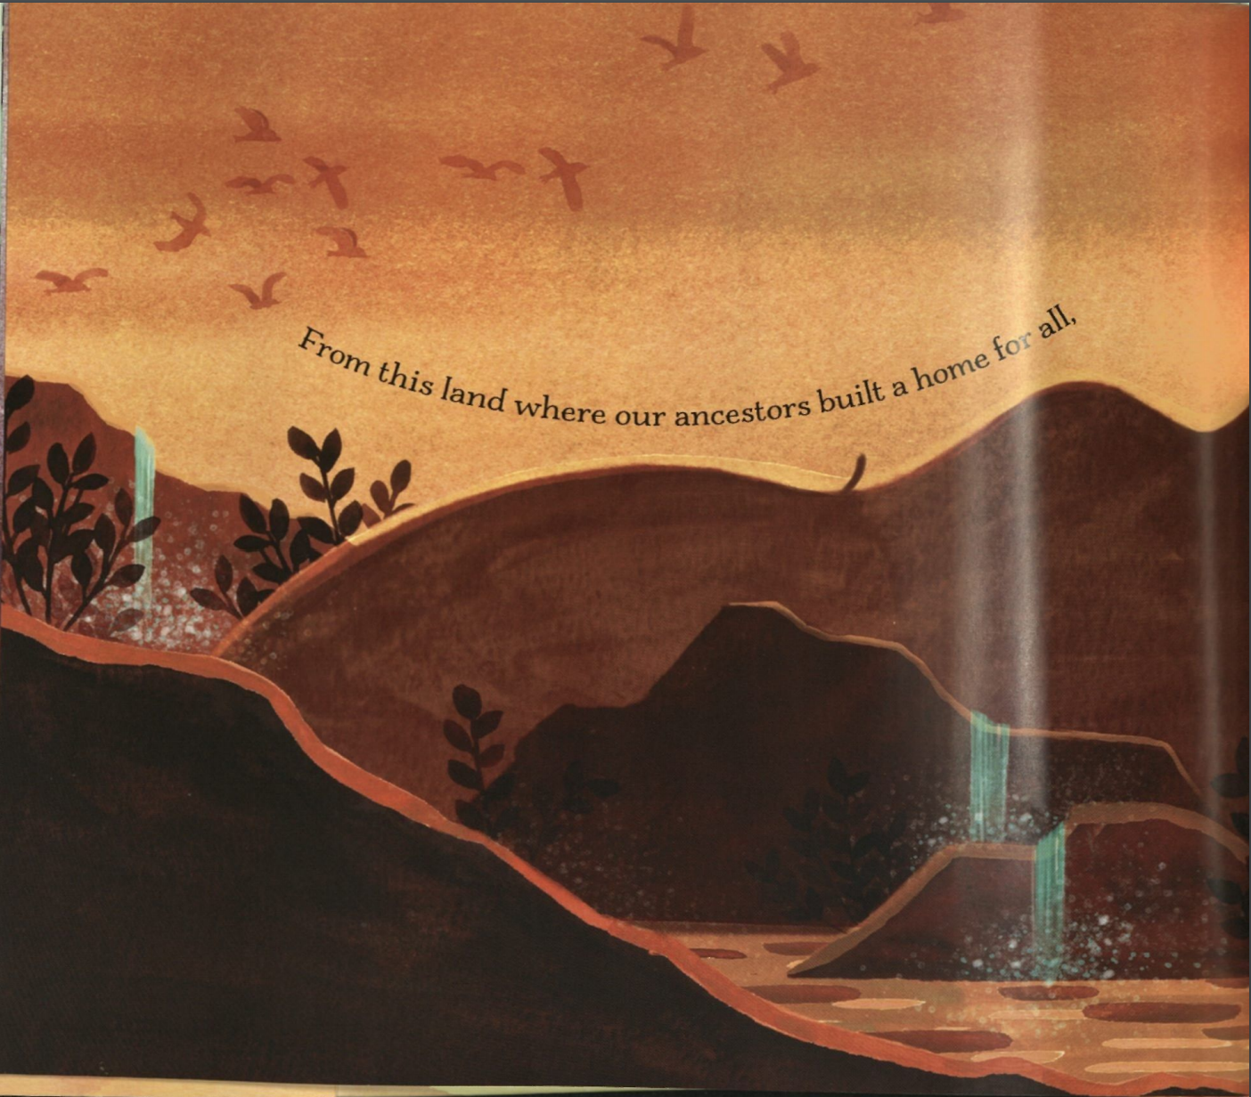
Notes:
Everyone has their own unique history and story- what makes you you! We are going to show eachother today. Split up into half the group-- THey will make shape walk around and observe the shapes.One group make shape Now who are you next to? They are your partner. Notice their shape . Are they high low or medium? Pause. Are they showing us how big the space is or all how little the space is? Does their shape seem heavy and strong? Or is it light, airy and delicate? Does it look like they could hold it for forever? Or that they got frozen in the middle of doing something?

Slide 13
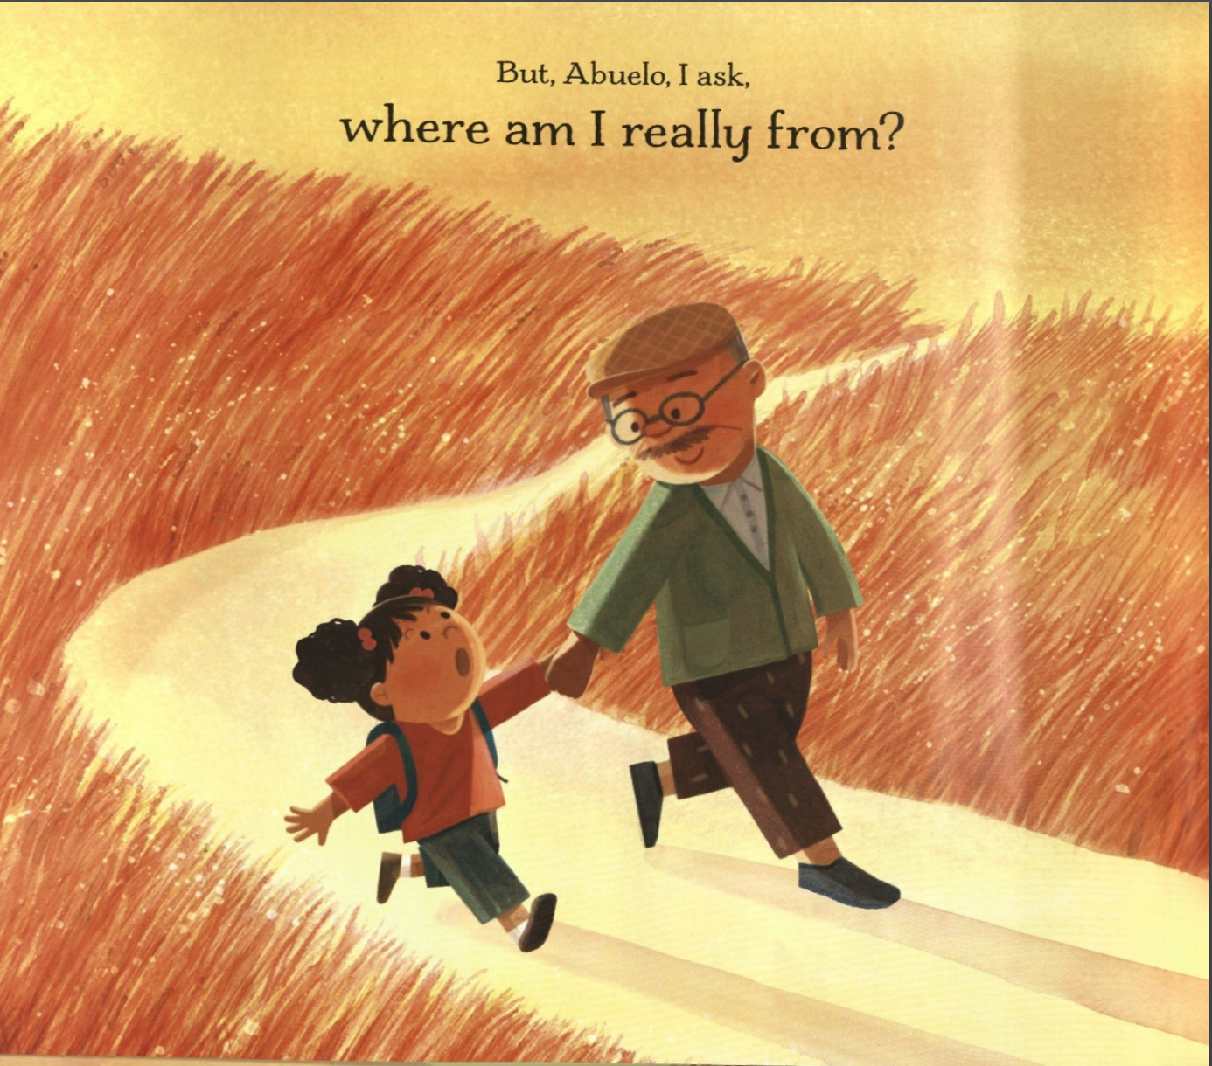
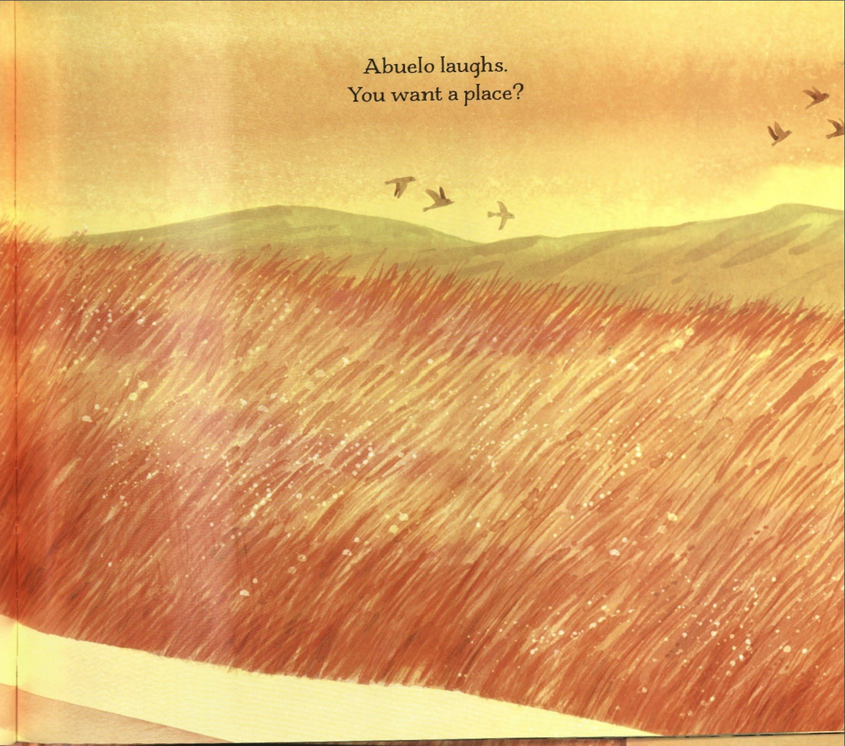

Slide 14
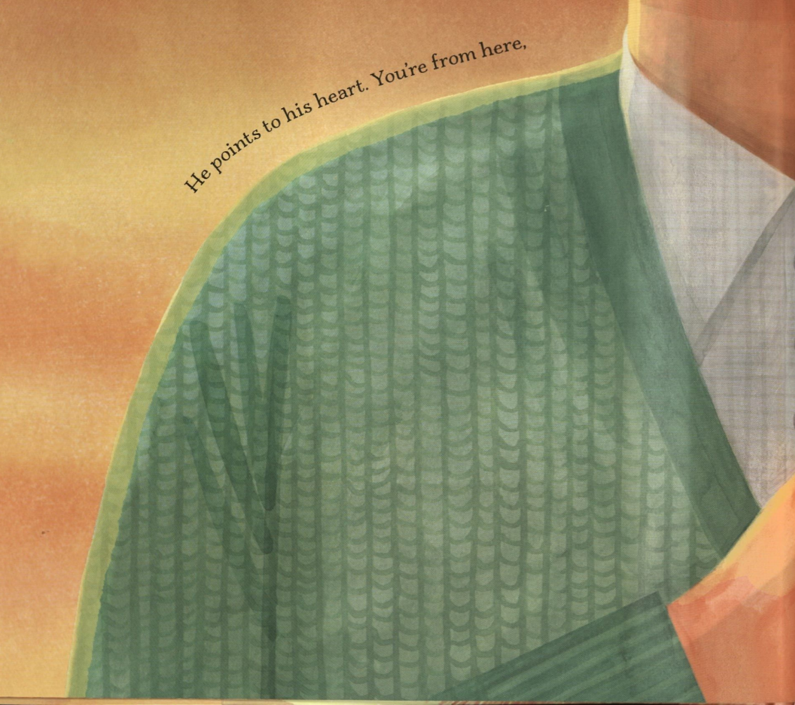
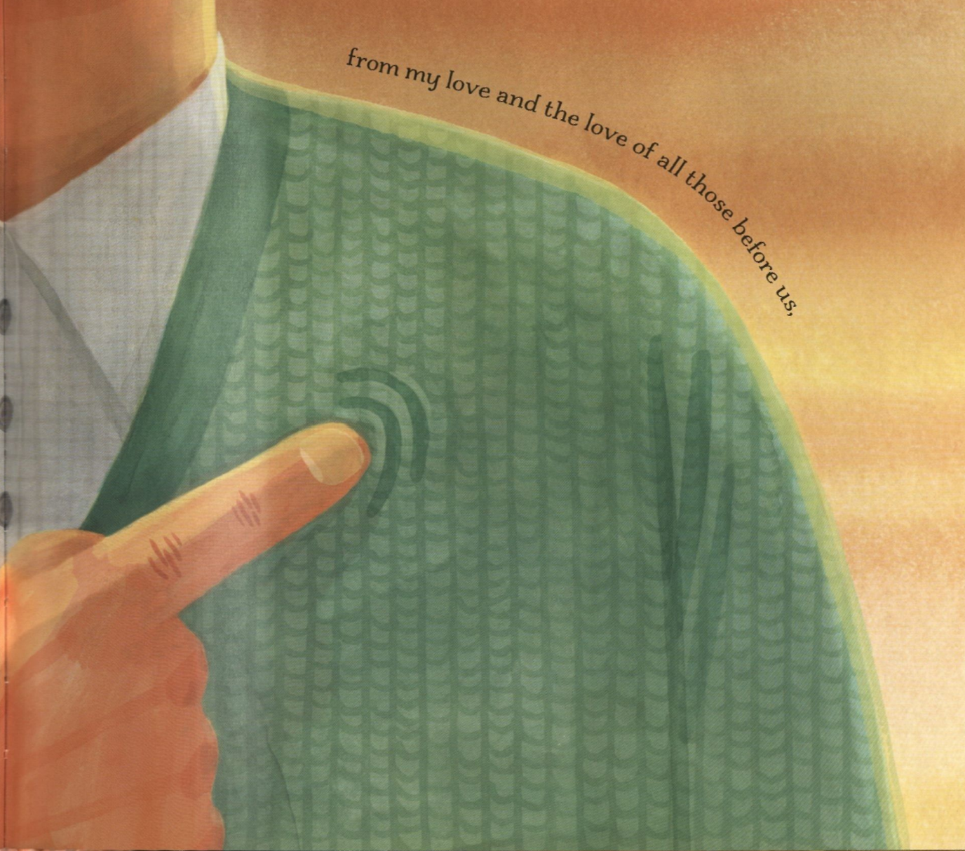
We can each contribute different things and learn much from each other. Mirroring.
Notes:
Find partner: WE are going to copy how they move but not just their movement. If they are moving slow move slow if they look they are light and airy move airy. I wan you to really loook not just with your eyes but sense how they are moving and try to copy it. Now switch

Slide 15
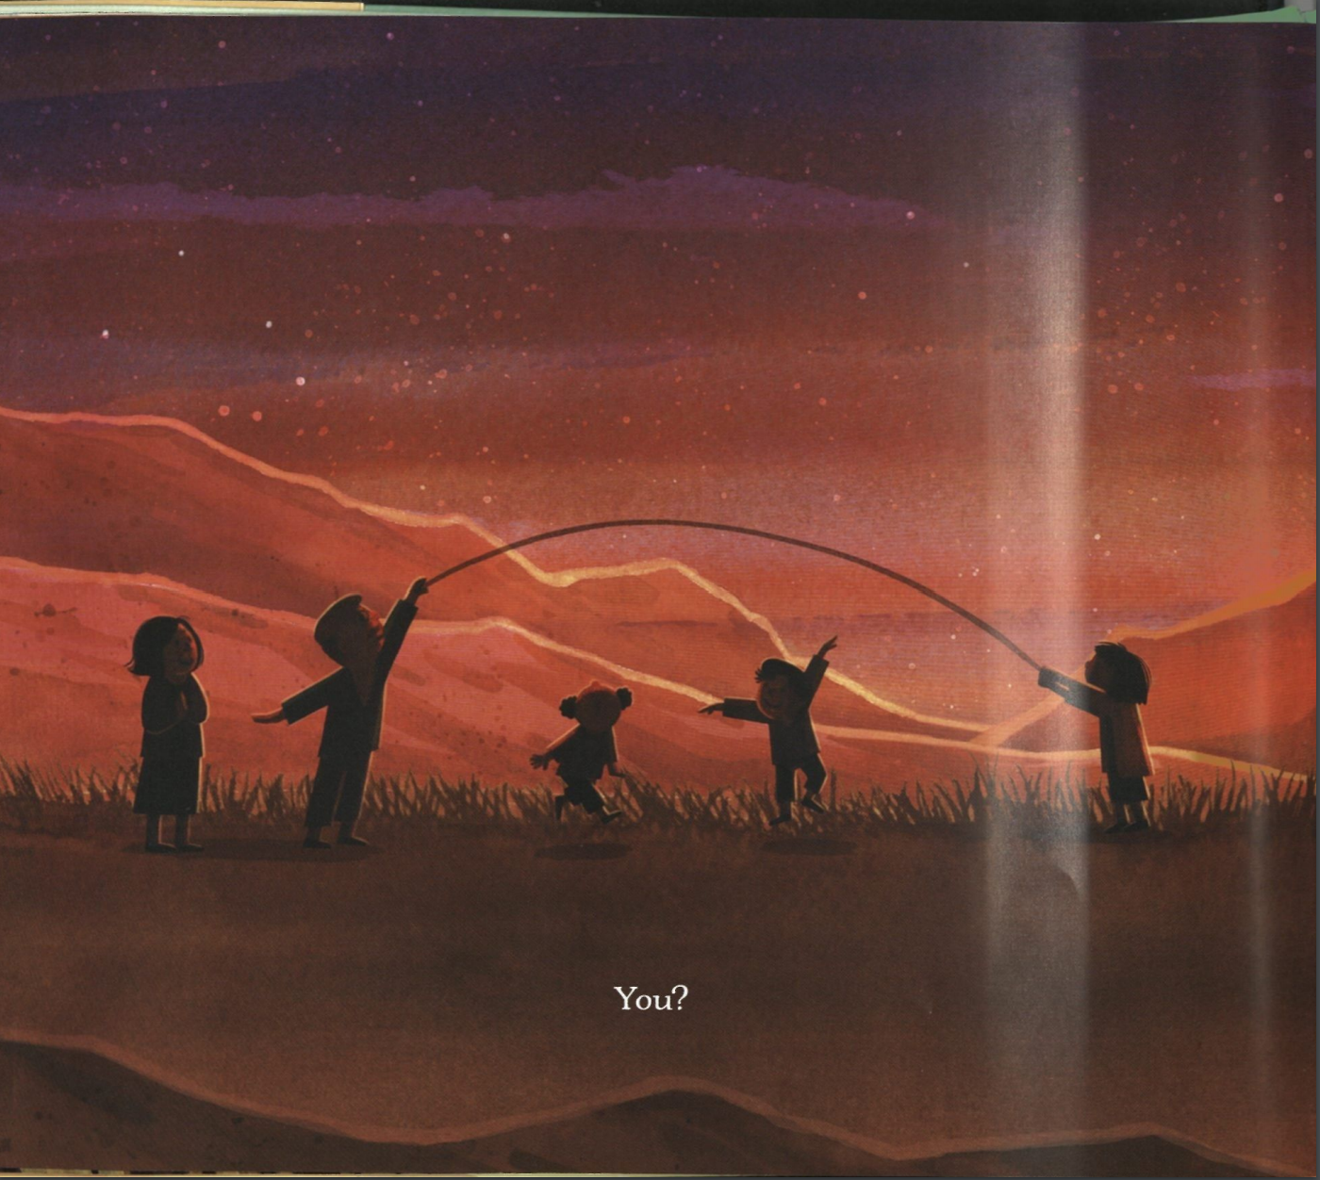
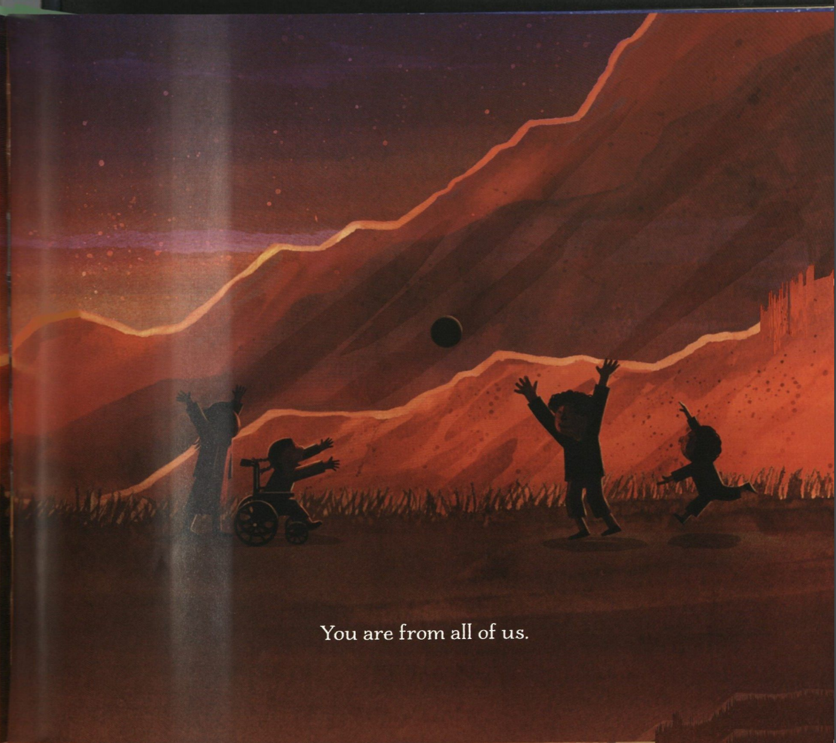
Have you ever been to a museum?
If YOU were in a museum, what interesting shape would you like everyone to see?
Notes:
Arlight with this same partner I wan you to make the shape you made in the shape museusem nd face eachother with your shape. Alright ready go Look at their shape look at your own shape. How is their shape different than your shape? How is it the same? ARe you on the same level? Do you have the same weight? ARe you looking inteh same place?
Two people share
Now can you find something abou their shape and add it your shape without changing yours all the way? It might change a little and that is great! Look now you are making a new shape!

Slide 16
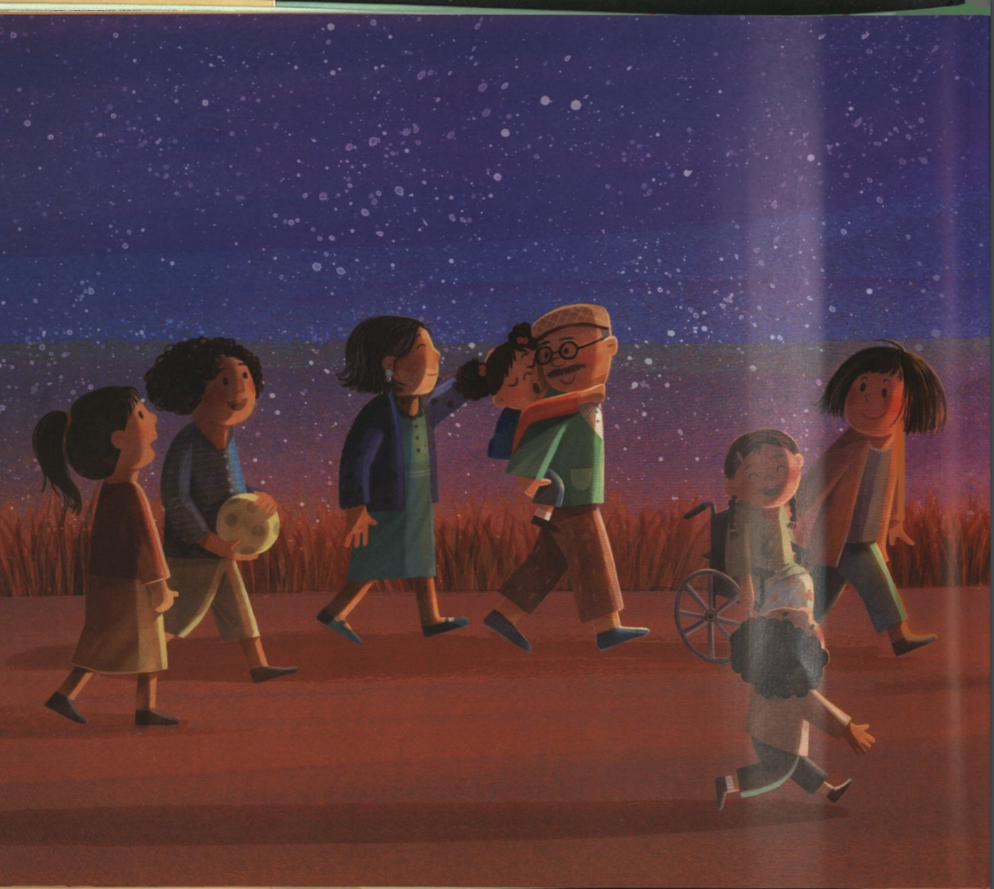
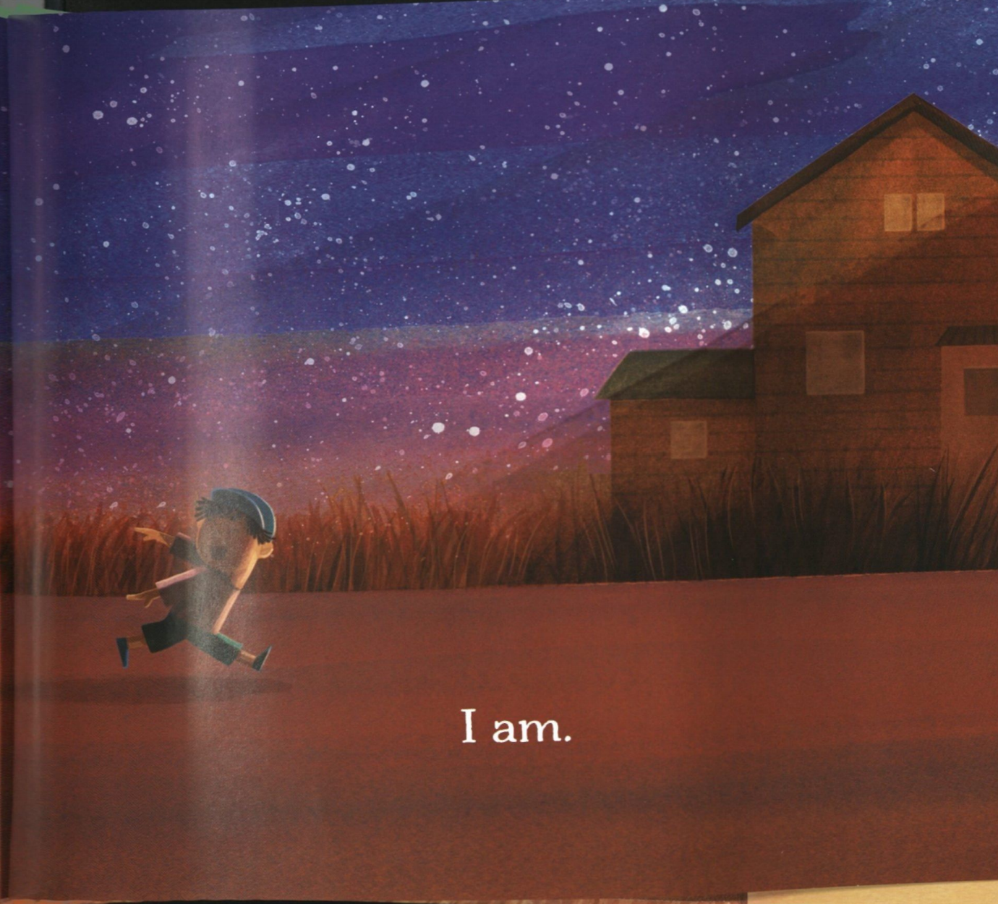
Notes:
We all come from different backgrounds, families, some of us are from places really far away some of us have lived in this town our whole life. But when we look at how others live their life and their background and choose to earn from them our lives become more exciting. Just like we looked at eachother’s shapes and changed out own shape to make it more exciting. WAnt you to think in your own head---- what is one way I like to move differently than others? Did you prefer moving like the birds and clouds-- light and free, fast or slow like the river , big and wide like the prairie or still like the museum shapes?

